Slide 1
Music Genre Classification
Link : - https://www.kaggle.com/dapy15/music-genre-classification

Slide 2
My learning through this project :
Grid Search is a very useful weapon.
Grid Search comes handy when we are unable to decide what parameters to use while building a model.

Slide 3
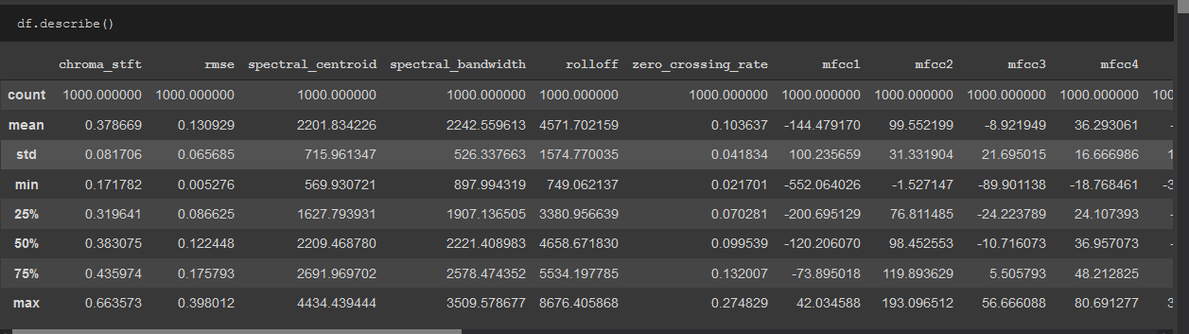
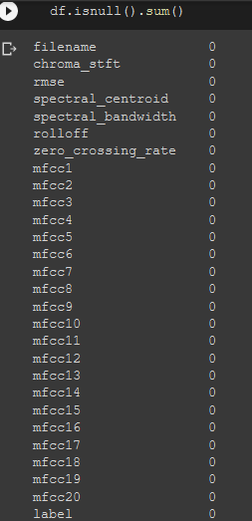
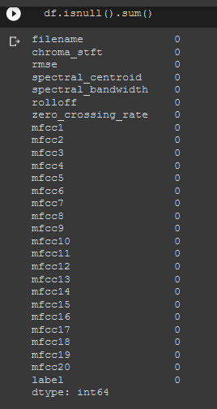

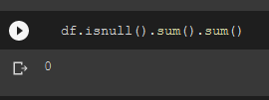
Data Inspection

Slide 4
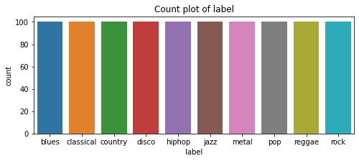
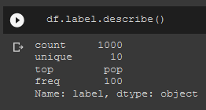
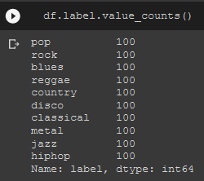
LAbel (Response Variable)

Slide 5
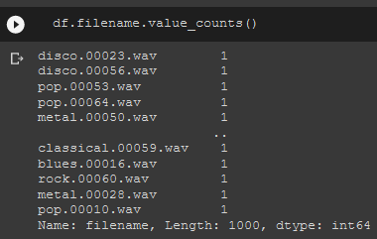

Filename
‘Filename’ can be dropped

Slide 6
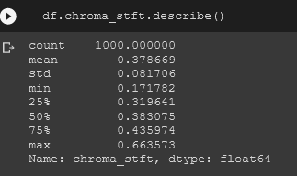
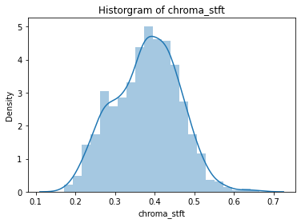
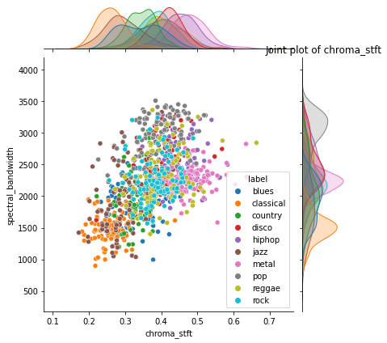
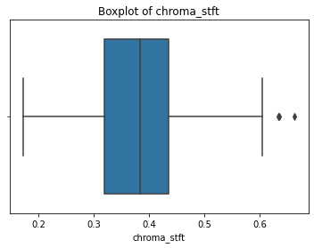
chroma_stft (Continuous Variable)
* Few outliers are there, treatment was done

Slide 7
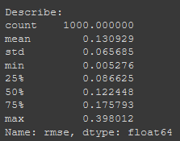
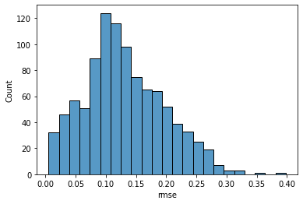
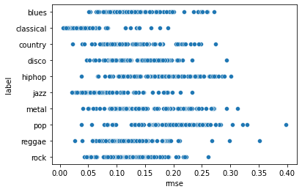
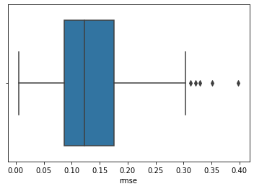
Rmse (Continuous Variable)
Histogram of rmse
scatter plot of rmse
Boxplot of rmse
* Few outliers are there, treatment was done

Slide 8
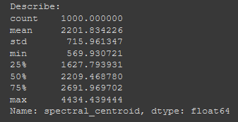
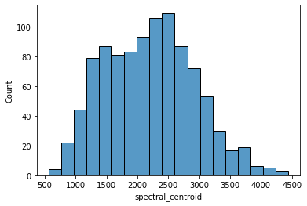
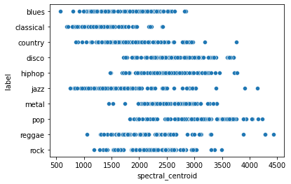
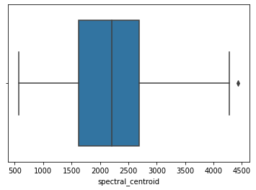
spectral_centroid
Histogram of spectral_centroid
scatter plot of spectral_centroid
* Only one outlier, replaced it with Lower limit
Boxplot of spectral_centroid

Slide 9
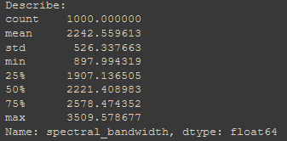
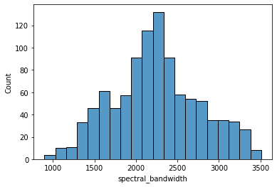
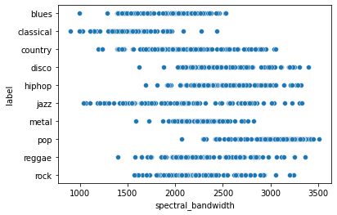
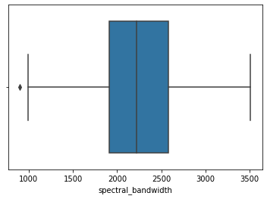
spectral_bandwidth
Histogram of spectral_bandwidth
scatter plot of spectral_bandwidth
* Only one outlier, replaced it with Lower limit
Boxplot of spectral_bandwidth

Slide 10
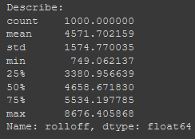
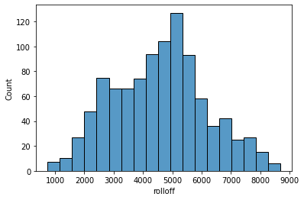
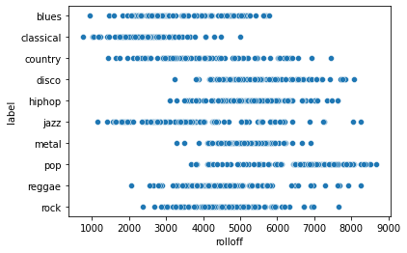
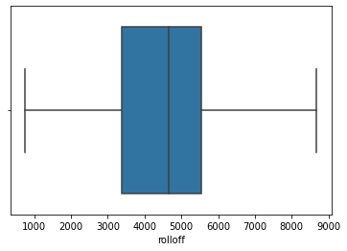
rolloff
Histogram of rolloff
scatter plot of rolloff
*No Outliers
Boxplot of rolloff

Slide 11
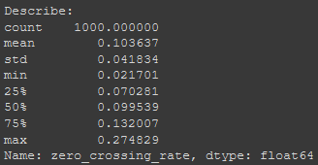
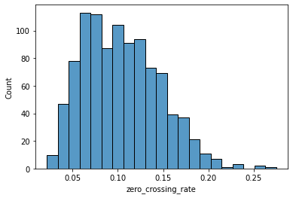
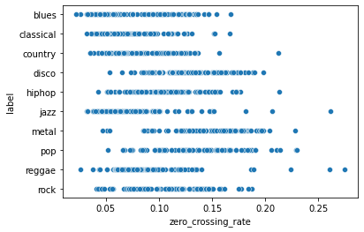
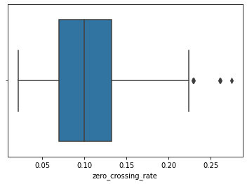
zero_crossing_rate
Histogram of zero_crossing_rate
scatter plot of zero_crossing_rate
Boxplot of zero_crossing_rate
* Few outliers are there, treatment was done

Slide 12
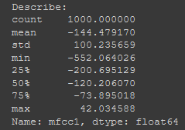
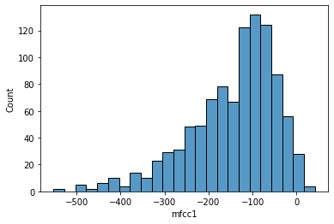
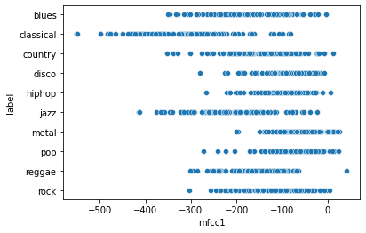
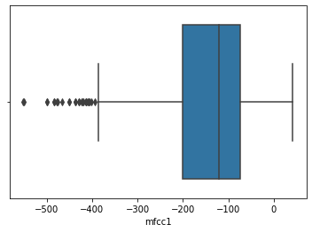
mfcc1
Histogram of mfcc1
scatter plot of mfcc1
Boxplot of mfcc1
* Outliers present, treatment was done

Slide 13
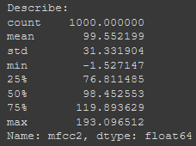
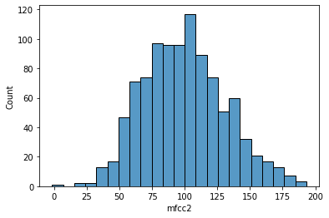
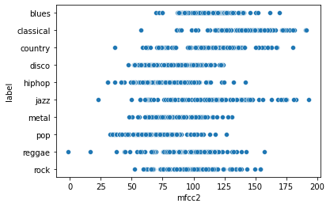
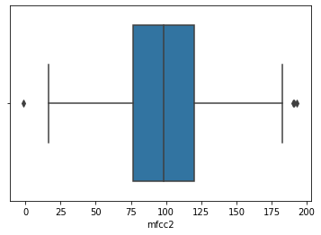
mfcc2
Histogram of mfcc2
scatter plot of mfcc2
Boxplot of mfcc2
* Few outliers are there, treatment was done

Slide 14
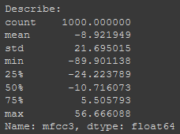
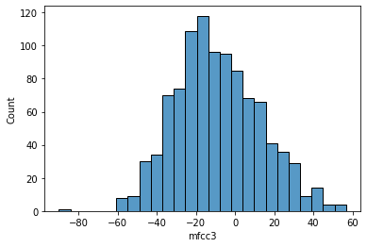
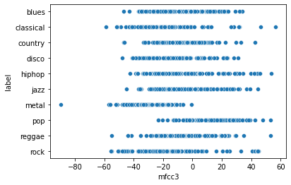
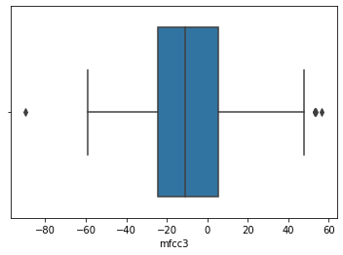
mfcc3
Histogram of mfcc3
scatter plot of mfcc3
Boxplot of mfcc3
* Few outliers are there, treatment was done

Slide 15
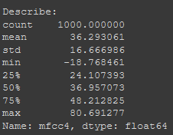
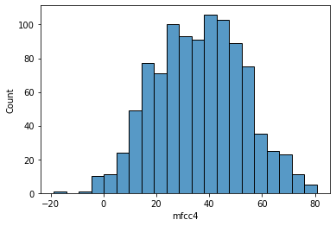
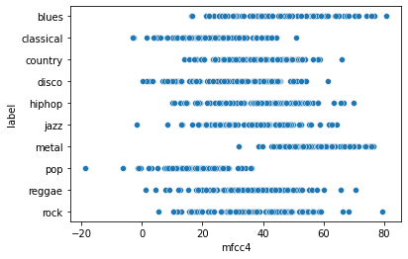
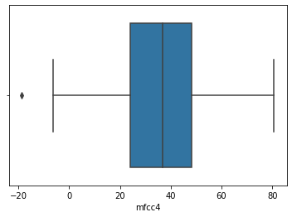
mfcc4
Histogram of mfcc4
scatter plot of mfcc4
Boxplot of mfcc4
* One Outlier, replaced with lower limit

Slide 16
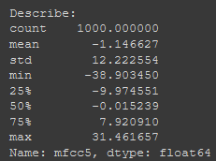
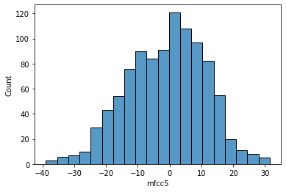


mfcc5
Histogram of mfcc5
scatter plot of mfcc5
Boxplot of mfcc5
* One Outlier, replaced with lower limit

Slide 17




mfcc6
Histogram of mfcc6
scatter plot of mfcc6
Boxplot of mfcc6
* One Outlier, replaced with lower limit

Slide 18




mfcc7
Histogram of mfcc7
scatter plot of mfcc7
Boxplot of mfcc7
*No outliers.

Slide 19




mfcc8
Histogram of mfcc8
scatter plot of mfcc8
Boxplot of mfcc8
* 2 Outliers, treatment was done

Slide 20




mfcc9
Histogram of mfcc9
scatter plot of mfcc9
Boxplot of mfcc9
* One outlier present

Slide 21




mfcc10
Histogram of mfcc10
scatter plot of mfcc10
Boxplot of mfcc10
*No Outliers

Slide 22




mfcc11
Histogram of mfcc11
scatter plot of mfcc11
Boxplot of mfcc11
* 3 Outliers, treatment was done

Slide 23




mfcc12
Histogram of mfcc12
scatter plot of mfcc12
Boxplot of mfcc12
*No Outliers

Slide 24




mfcc13
Histogram of mfcc13
scatter plot of mfcc13
Boxplot of mfcc13
* One Outlier, treated it

Slide 25




mfcc14
Histogram of mfcc14
scatter plot of mfcc14
Boxplot of mfcc14
* Few outliers are there, treatment was done

Slide 26




mfcc15
Histogram of mfcc15
scatter plot of mfcc15
Boxplot of mfcc15
* Few outliers are there, treatment was done

Slide 27




mfcc16
Histogram of mfcc16
scatter plot of mfcc16
Boxplot of mfcc16
* Few outliers are there, treatment was done

Slide 28




mfcc17
Histogram of mfcc17
scatter plot of mfcc17
Boxplot of mfcc17
* Few outliers are there, treatment was done

Slide 29




mfcc18
Histogram of mfcc18
scatter plot of mfcc18
Boxplot of mfcc18
* Few outliers are there, treatment was done

Slide 30




mfcc19
Histogram of mfcc19
scatter plot of mfcc19
Boxplot of mfcc19
* Few outliers are there, treatment was done

Slide 31




mfcc20
Histogram of mfcc20
scatter plot of mfcc20
Boxplot of mfcc20
* There are many outliers, treatment was done

Slide 32


Used “for-loop” to check:
To check missing(Null, Nan, na, n/a) values
To print “value counts” of the variable
To print “describe” the variable
To “fill nan” values
To plot “Countplot” of the variable
To plot “Histogram” of the variable
To plot “Boxplot” of the variable
To plot “Scatter plot” of the variable
Used “for-loop” with lambda function for Outliers treatment

Slide 33

Heatmap(Correlation)

Slide 34







PCA

Slide 35






Model (Logistic Regression – Grid Search)
*Accuracy on test dataset is 0.45

Slide 36




Model (Decision Tree)
CCP_alpha = 0.011

Slide 37




Model (Decision Tree)
CCP_alpha = 0.011
*Accuracy on test dataset is 0.40

Slide 38




Model (random forest)
CCP_alpha = 0.011
*Accuracy on test dataset is 0.48

Slide 39




Model (Ada Boosting)
*Accuracy on test dataset is 0.36

Slide 40





Model (Gradient Boosting)
*Accuracy on test dataset is 0.46

Slide 41






Model (KNN)
*Accuracy on test dataset is 0.50

Slide 42





Model (KNN – grid search)
*Accuracy on test dataset is 0.50

Slide 43





Model (SVM – Grid Search)
*Accuracy on test dataset is 0.51

Slide 44

Accuracy of all the Models

Slide 45

Thank You

